Slide 1
Chapter 7-2
Router Fundamentals

Slide 2
Introduction
This section further defines the function of a router in a network and describes how data packets travel through a layer 3 network.
A layer 3 network uses IP addressing for routing data packets to the final destination.
Delivery of the data packets over the layer 3 network is made possible by the use of a destination MAC address, IP address, network addresses, and routing tables.
Each of these concepts are examined in this section.

Slide 3
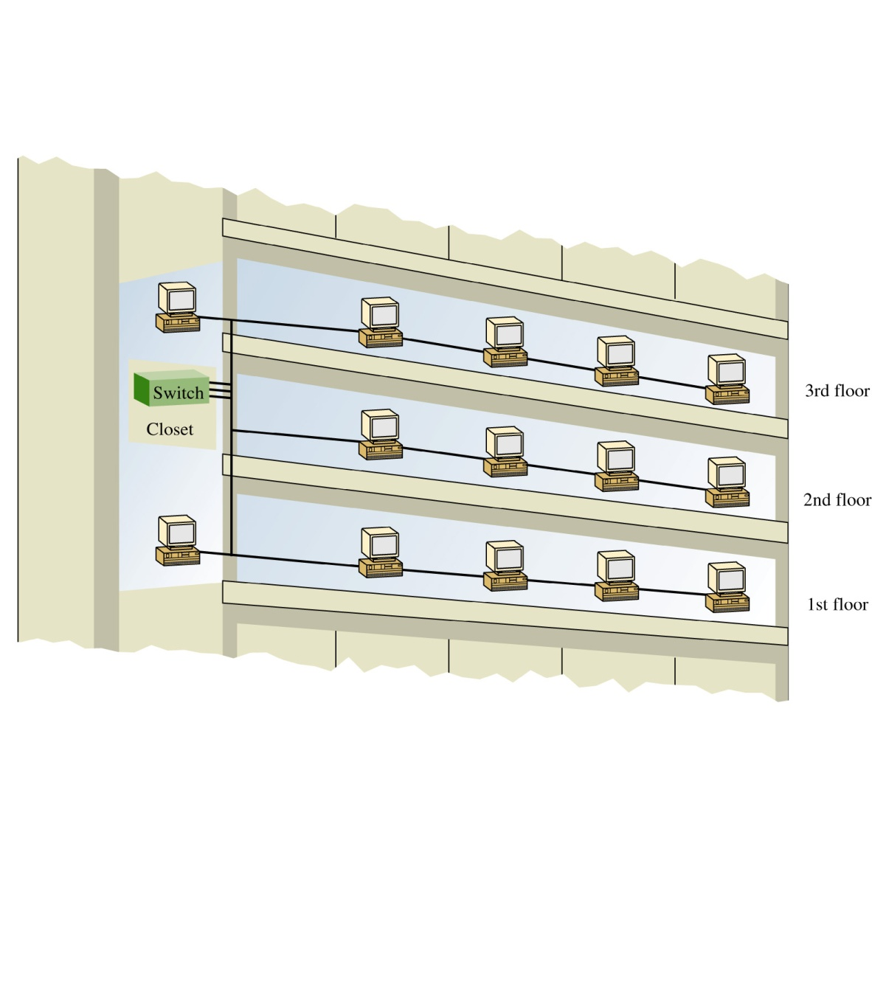
LANs sizes are not necessarily restricted in size. A LAN can have 20, 200 computers or even more. There can also be multiple LANs interconnected that essentially create one large LAN.
For example, the first floor of a building could be set-up as one LAN, the second floor a LAN, and the third floor another. The three LANs in the building can be interconnected into essentially one large LAN using switches and the switches interconnected as show.

Slide 4
Is it bad to interconnect
LANs this way?
As long as switches are being used to interconnect the computers, the impact of the interconnected LANs has minimal impact on network performance.
This is true as long as there are not to many computers in the LAN. The number of computers in the LAN is an issue because layer 2 switches do not separate broadcast domains.

Slide 5
Broadcast Domains
This means that any broadcast sent out on the network (e.g. the broadcast associated with an ARP request) will be sent to all computers in the LAN.
Excessive broadcasts are a problem because each computer must process the broadcast to determine if it needs to respond and this takes computer processing time.
This essentially slows down the computer and the network.

Slide 6
Flat Network
A network with multiple LANs interconnected together at the layer 2 level is called a flat network. A flat network is where the LANs share the same broadcast domain.
The use of a flat network should be avoided if possible for the simple reason that the network response time is greatly affected.
Flat networks can be avoided by the use of layer 3 networks. This is the next topic.

Slide 7
Layer 3 Networks
In a simple office type LAN introduced in Chapter 1 and the building LAN just discussed, the hosts are interconnected with a hub or switch. This allows data to be exchanged within the LAN however data cannot be routed to other networks.
Also, the broadcast domain of one LAN is not isolated from another LAN’s broadcast domain. The solution for breaking up the broadcast domains and to provide network routing is to incorporate routing hardware into the network design to create a routed network. A routed network uses layer 3 addressing for selecting routes to forward data packets. A better name for a routed network is a layer 3 network.

Slide 8
Layer 3 Networks
In layer 3 networks, routers and layer 3 switches are used to interconnect the networks and LANs
This isolates broadcast domains
Enables hosts from different LANs and networks to exchange data.
Data packet delivery is achieved by handing off the data to adjacent routers until the data reaches its final destination. This typically incorporates the passing of data packets through many routers and many networks.

Slide 9
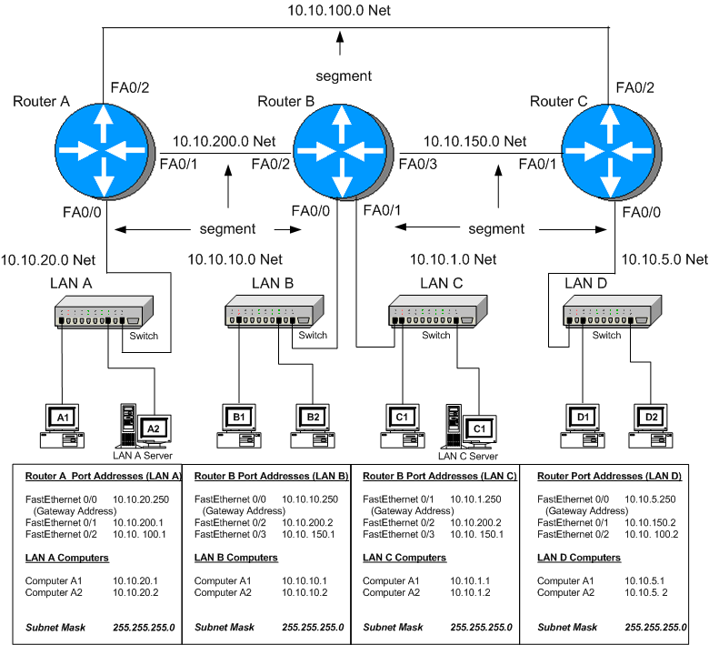

Slide 10
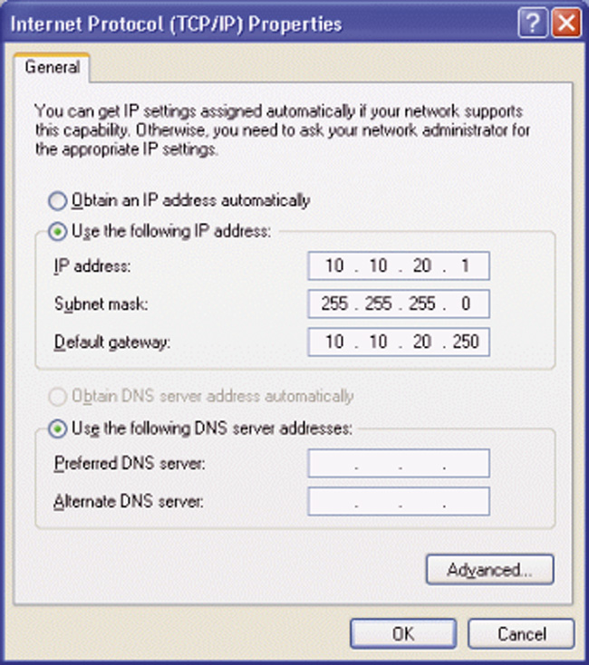
The default gateway address is the IP address of a networking device (e.g. router) used to forward data that needs to exit the LAN.
An example of a setting a computer’s default gateway is provided. The default gateway address for computer A is 10.10.20.250.
This is the IP address of RouterA’s FastEthernet 0/0 port. Fig. 6-2 shows that RouterA’s FA0/0 port connects directly to the switch in LAN A.

Slide 12
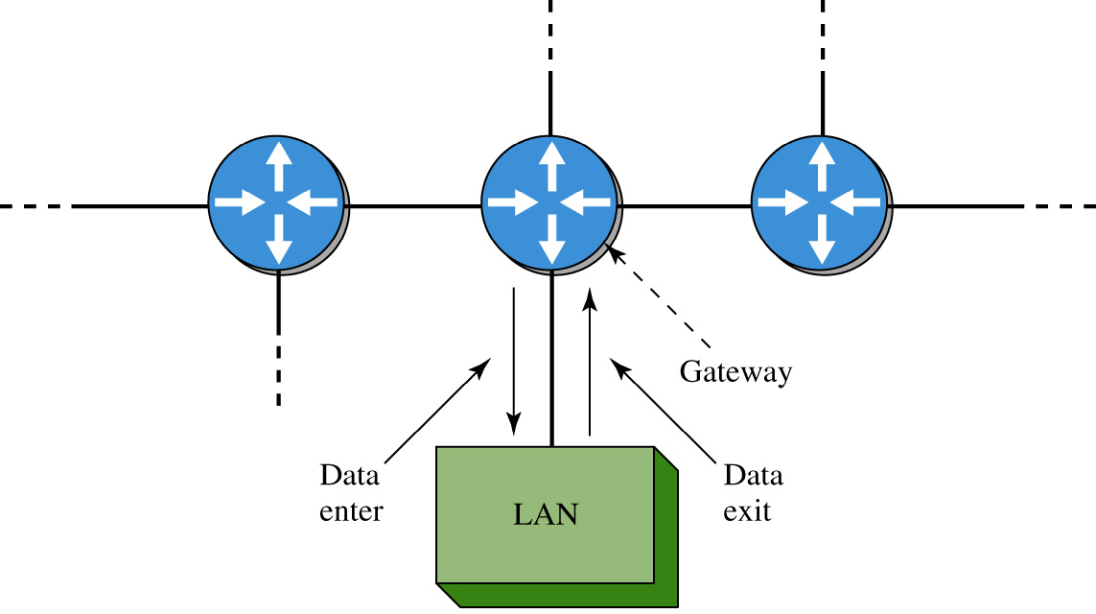
The term gateway is a term used to describe the networking device that enables data to enter and exit a LAN. The gateway is where the host computers forward data packets that need to exit the LAN.

Slide 13
In most networks, the gateway is typically a router or switch port address. An example of a gateway is provided in the block diagram shown. The block shows that data enters and exit the LAN via the gateway.

Slide 14
Example 7-1
Problem:
A computer host sends two data packets out on the network. Each data packet has a different IP destination addresses. Determine if the data packets are to be forwarded to the default gateway or should remain in the same LAN as the host.
The source host IP address is 10.10.20.2, and a subnet mask of 255.255.255.0 is being used. The destination IP address for the data packets are 10.10.1.1 and 10.0.20.3.
Pause the player, solve the problem, then start the player to check your answer.

Slide 15
Example 7-1
Solution:
First determine the network or subnet where the source host resides. This can be determined by “ANDing” the subnet mask with the source host IP address as shown.
Remember, the subnet masking is a binary “AND” operation.
source IP address: 10. 10. 20. 2
subnet mask 255. 255. 255. 0
______________
10. 10. 20. 0
Therefore the source host is in the 10.10.20.0 subnet

Slide 16
Example 7-1
Determine the destination network for the data
packet given the following information:
a destination IP address: 10. 10. 1. 1
subnet mask 255.255.255. 0 _____________
subnet 10. 10. 1. 0
Answer: The destination subnet address for part (a) is 10.10.1.0. This not in the same subnet as the 10.10.20.2 host (10.10.20.0 NET), therefore the data packet is forwarded to the default gateway.

Slide 17
Example 7-1
(b) Determine the destination network for a data packet
given the following information:
destination IP address: 10. 10. 20. 3
subnet mask 255. 255. 255. 0
_____________
subnet 10. 10. 20. 0
Answer: The destination subnet for part (b) is 10.10.20.0 which is the same subnet as the host therefore the data packet remains in the 10.10.20.0 subnet.

Slide 18
next hop address
The IP address of the data packet sent from the source computer to the gateway, is examined by the router and a next hop address is selected.
The gateway examines the destination IP address of all data packets arriving at its interface. The router uses a routing table to determine a network data path and the next hop address.
A routing table is a list of the possible networks that can be used to route the data packets.

Slide 19
Alternate Data Paths
Alternate data paths are usually provided so that a new route can be selected and data delivery maintained even if a network route is down.
The next hop address is the IP address of the next networking device that can be used to forward the data packet to the destination.

Slide 21
MAC Addresses
The MAC addresses are used to define the hardware address of the next hop in the network.
The term next hop refers to the next networking device that is being used to relay the data packet to either an intermediate hop or possibly to the final destination.
Once the next hop is defined, the MAC address of the next hop is determined and the data packet is relayed.
Once the routes are fully configured, data packets can be exchanged between any LANs in the interconnected routed network.

Slide 23
segment
A segment in a network defines the physical link between two internetworking devices (e.g. router-hub, router-switch and a router-router).
For example, in an interconnected network, a segment is the name of the link between a router and another router.
Another example is the segment that connects a router to a LAN via a hub or a switch. Each network segment has its own network address.

Slide 24
In an interconnected network, a segment is the name of the link between a router and another router.

Slide 25
In an interconnected network, a segment is the name of the link between a router and another router.

Slide 26
In an interconnected network, a segment is the name of the link between a router and another router.

Slide 27
In an interconnected network, a segment is the name of the link between a router and another router.

Slide 28
Another example is the segment that connects a router to a LAN via a hub or a switch. Each network segment has its own network address.

Slide 29
Another example is the segment that connects a router to a LAN via a hub or a switch. Each network segment has its own network address.

Slide 30
For the small campus network shown, the network IP address for the segment connecting LAN A to the router is 10.10.20.0. All hosts connected to this segment must contain a 10.10.20.#. For example, Computer A1 is assigned the IP address 10.10.20.1.

Slide 31
subnet
The segment is sometimes called the subnet or NET. These terms are associated with a network segment address such as 10.10.20.0.
In this case, the network is called the 10.10.20.0 NET. All hosts in the 10.10.20.0 NET will have a 10.10.20.# IP address.

Slide 32
The network addresses are used when configuring the routers and defining what networks are connected to the router.
For example 10.10.20.0, 10.10.200.0, 10.10.100.0

Slide 33
Physical Layer Interface
The physical layer interface on the router provides a way to connect the router to other networking devices on the network.
For example, the Ethernet ports on the router are used to connect to other Ethernet ports on other routers.
Fast Ethernet and Gigabit Ethernet ports are available on routers to connect to other high speed Ethernet ports.

Slide 34
Physical Layer Interface
Routers also contain serial interfaces that are used to interconnect the router and the network to other serial communication devices.
For example, connection to Wide Area Networks requires the use of a serial interface to connect to a communications carrier such as Sprint, MCI, AT&T, etc.
The data speeds for the serial communication ports on routers are typically much slower than that data speeds available on Ethernet, FastEthernet, and Gigabit Ethernet. The range of the data speeds for the serial ports on the router are selectable from 2500 bps to 4 Mbps and even higher data rates.
Note: There are high speed serial communication links available for router connections to to/from ISPs. This is discussed in Chapter 8.

Slide 35
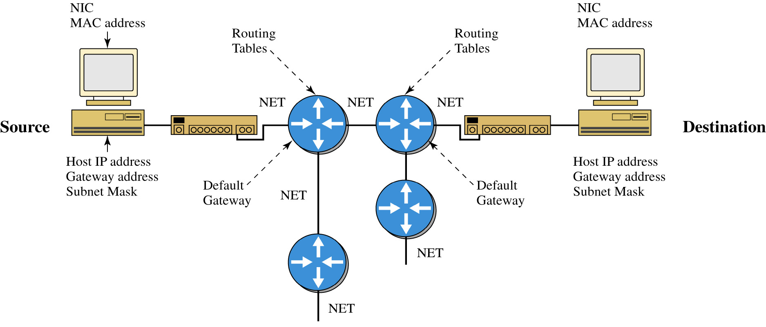
The figure shown is an example of a layer 3 network. The components that make up the layer 3 network are shown. The source host computer has an installed network interface card (NIC), an assigned IP address and subnet mask. The subnet mask is used to determine if the data is to stay in the LAN or is to be forwarded to the default gateway provided by the router. The router uses its subnet mask to determine the destination network address. The destination network address is checked with the router’s routing table to select the best route to the destination.

Slide 36
The data is then forwarded to the next router, the next router determines the destination network address, checks it routing table and forwards the data to the next hop. If the destination network is directly connected to the router then the router issues an ARP request to determine the MAC address of the destination host. Final delivery is then accomplished by forwarding the data using the destination host computer’s MAC address. Routing of the data through the networks is at layer 3 and the final delivery of data in the network is at layer 2.

Slide 37
Section 7-2 Key Terms
Broadcast Domain
Flat Network
Routed Network
Layer 3 Network
Default Gateway Address
Next Hop Address
Subnet, NET

